Slide 1
Shell Bootcamp 2024 3 Reflections for Week 1
Paryushi Jain
Date : 30-Aug-2024

Slide 2

About Me
The direction of your focus is the direction your life moves in. Let yourself move towards what is good, valuable and true.

Slide 3

My learnings from this week!

Slide 4
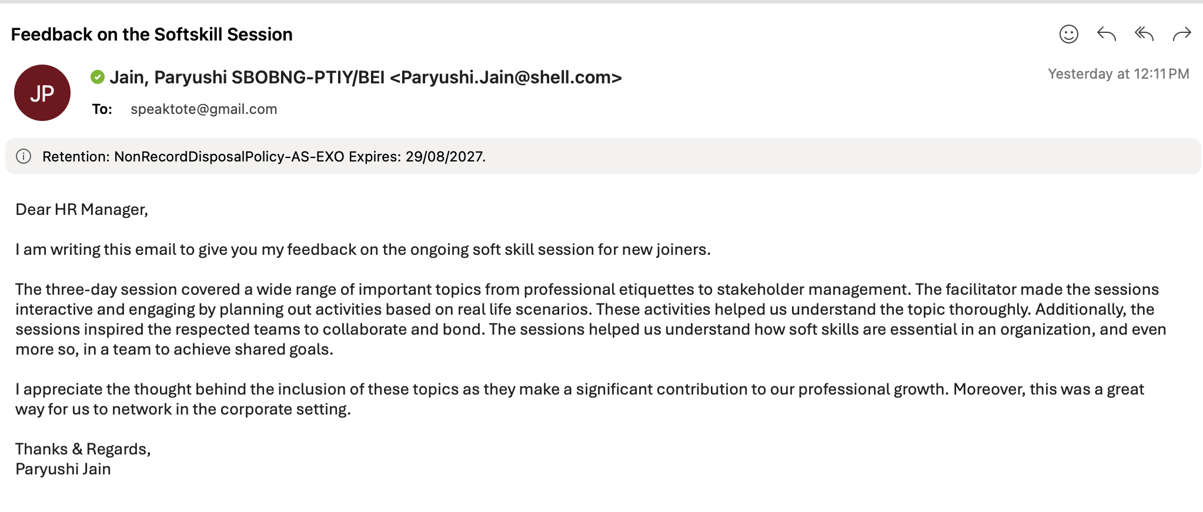
Learning 1 | My takeaways
Email Etiquettes
Email etiquettes help with clear communications. Professionalism is important to grow and maintain relationships.
POWER technique should be implemented while composing an email. This technique states, we should plan, organize, write, edit and review the mails before sending.
In energy sector, email etiquettes play a crucial role as there is a need for clear and professional communication with the stakeholders.

Slide 5
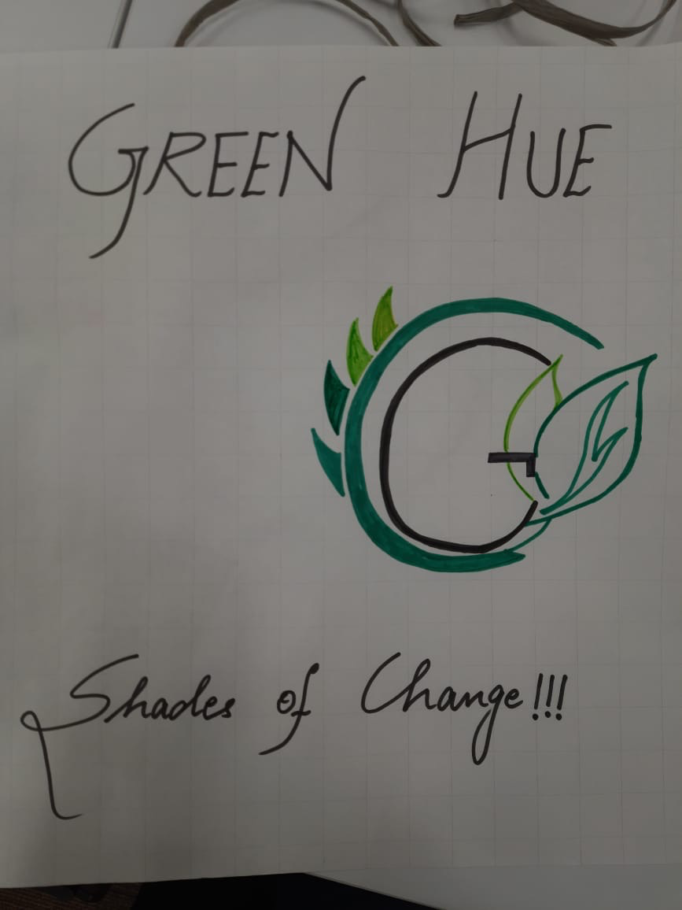
Learning 2 | My takeaways
Team work
Team work is a must in any work setting to strive as an individual.
Team work requires coordination, understanding, respecting opinions and joint efforts.
Energy sector being a complex and huge industry, it is crucial to be a part of the team.
Working as a team and coming up with a logo that resonates with us all.

Slide 6
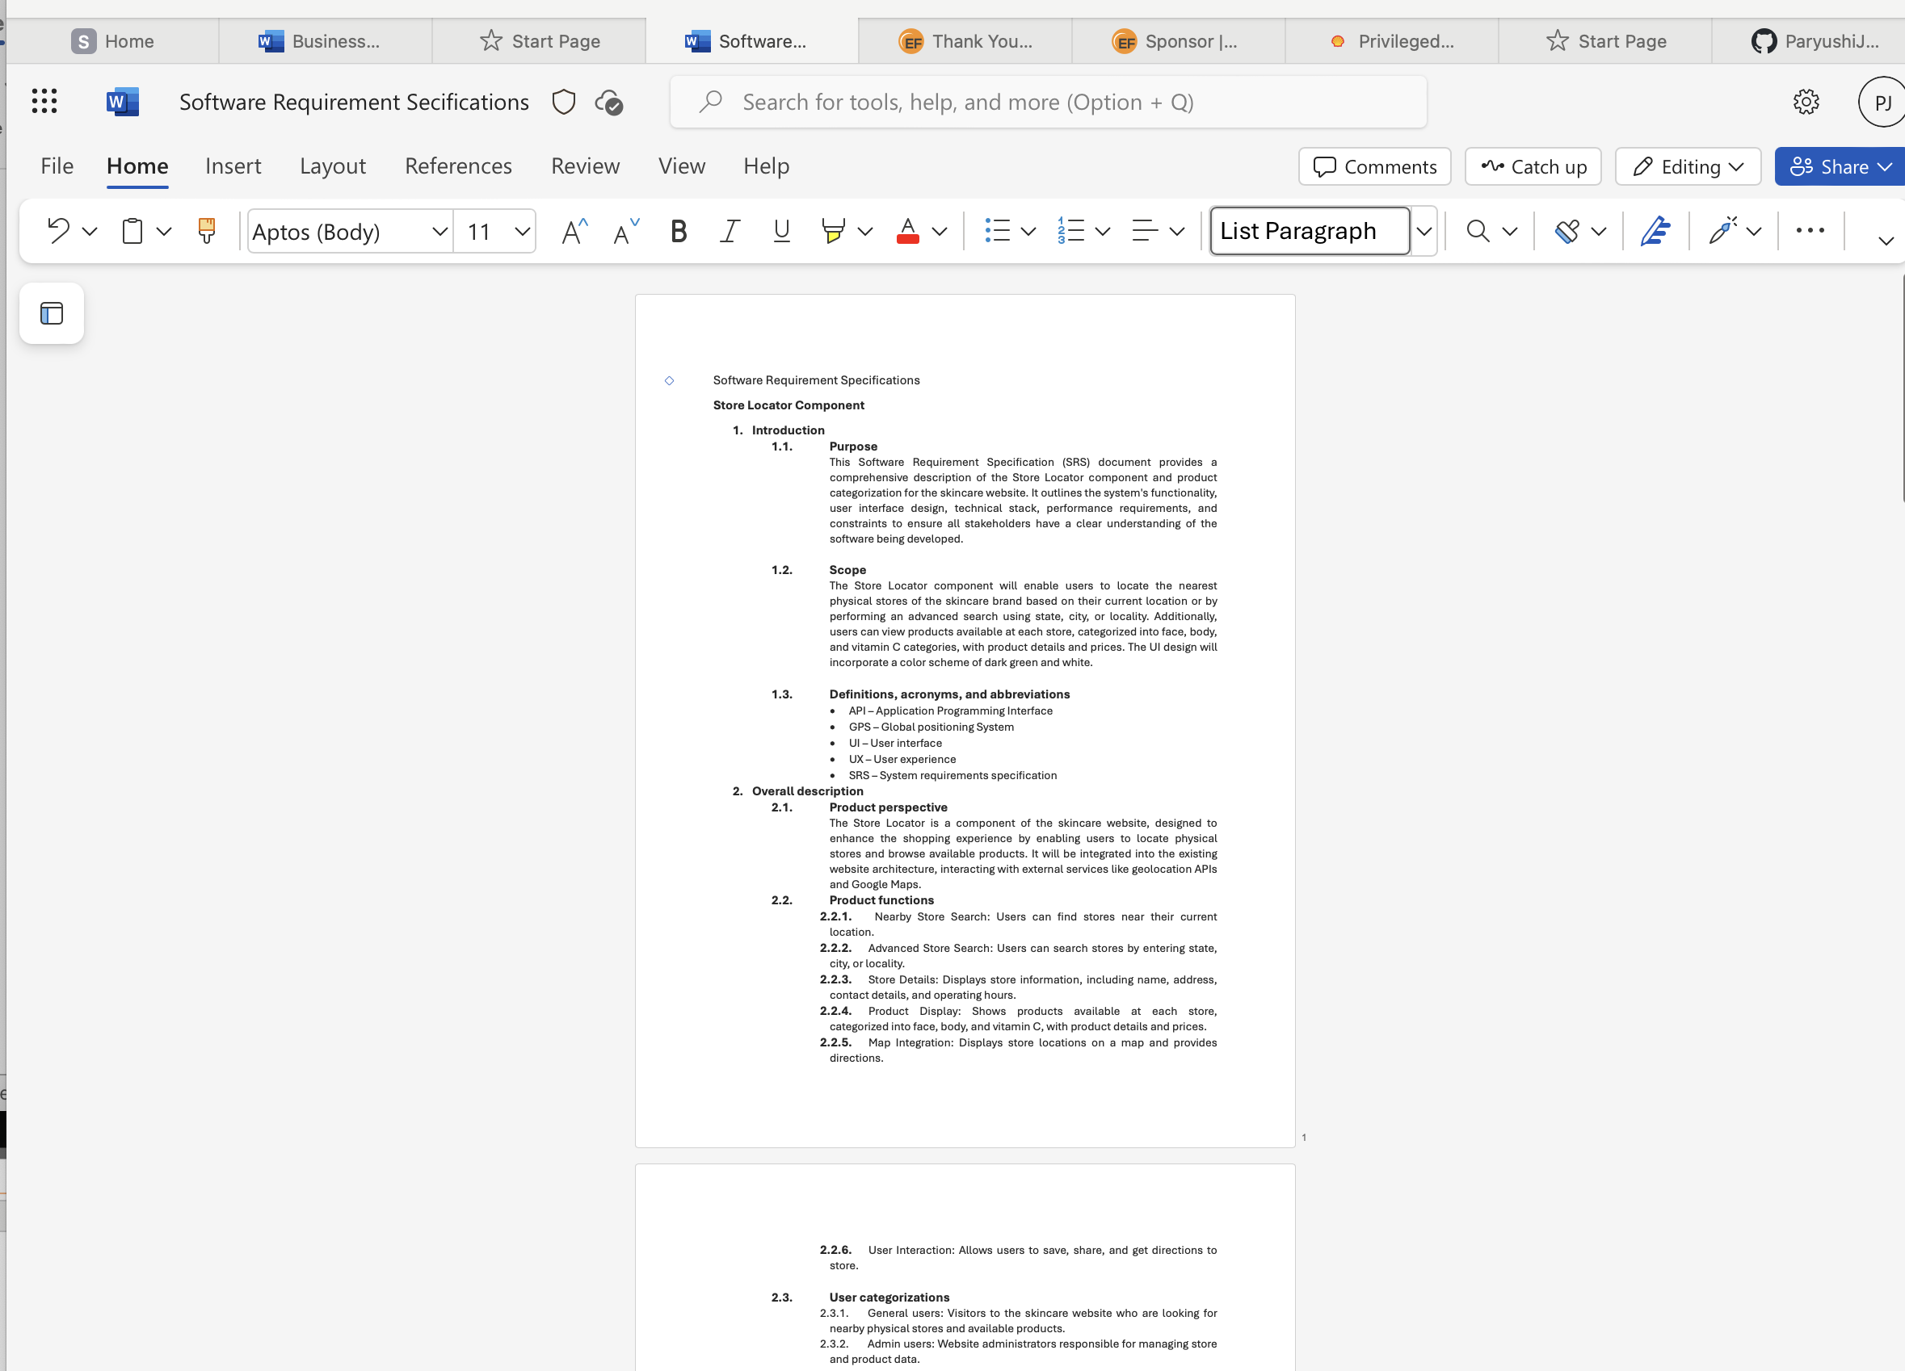
Learning 3 | My takeaways
Business Requirement Document and Agile Model
BRD helps with the high level picture of what the project may look like and how it would benefit the client. There are several models to implement SDLC, agile being the most effective.
Agile teams are responsive to change, even at the last minute, and can adapt to it without much disruption.
Agile approaches work because they actively engage and empower more people throughout the organization to define and drive change incrementally

Slide 7

Relevance of learnings for my organization

Slide 8
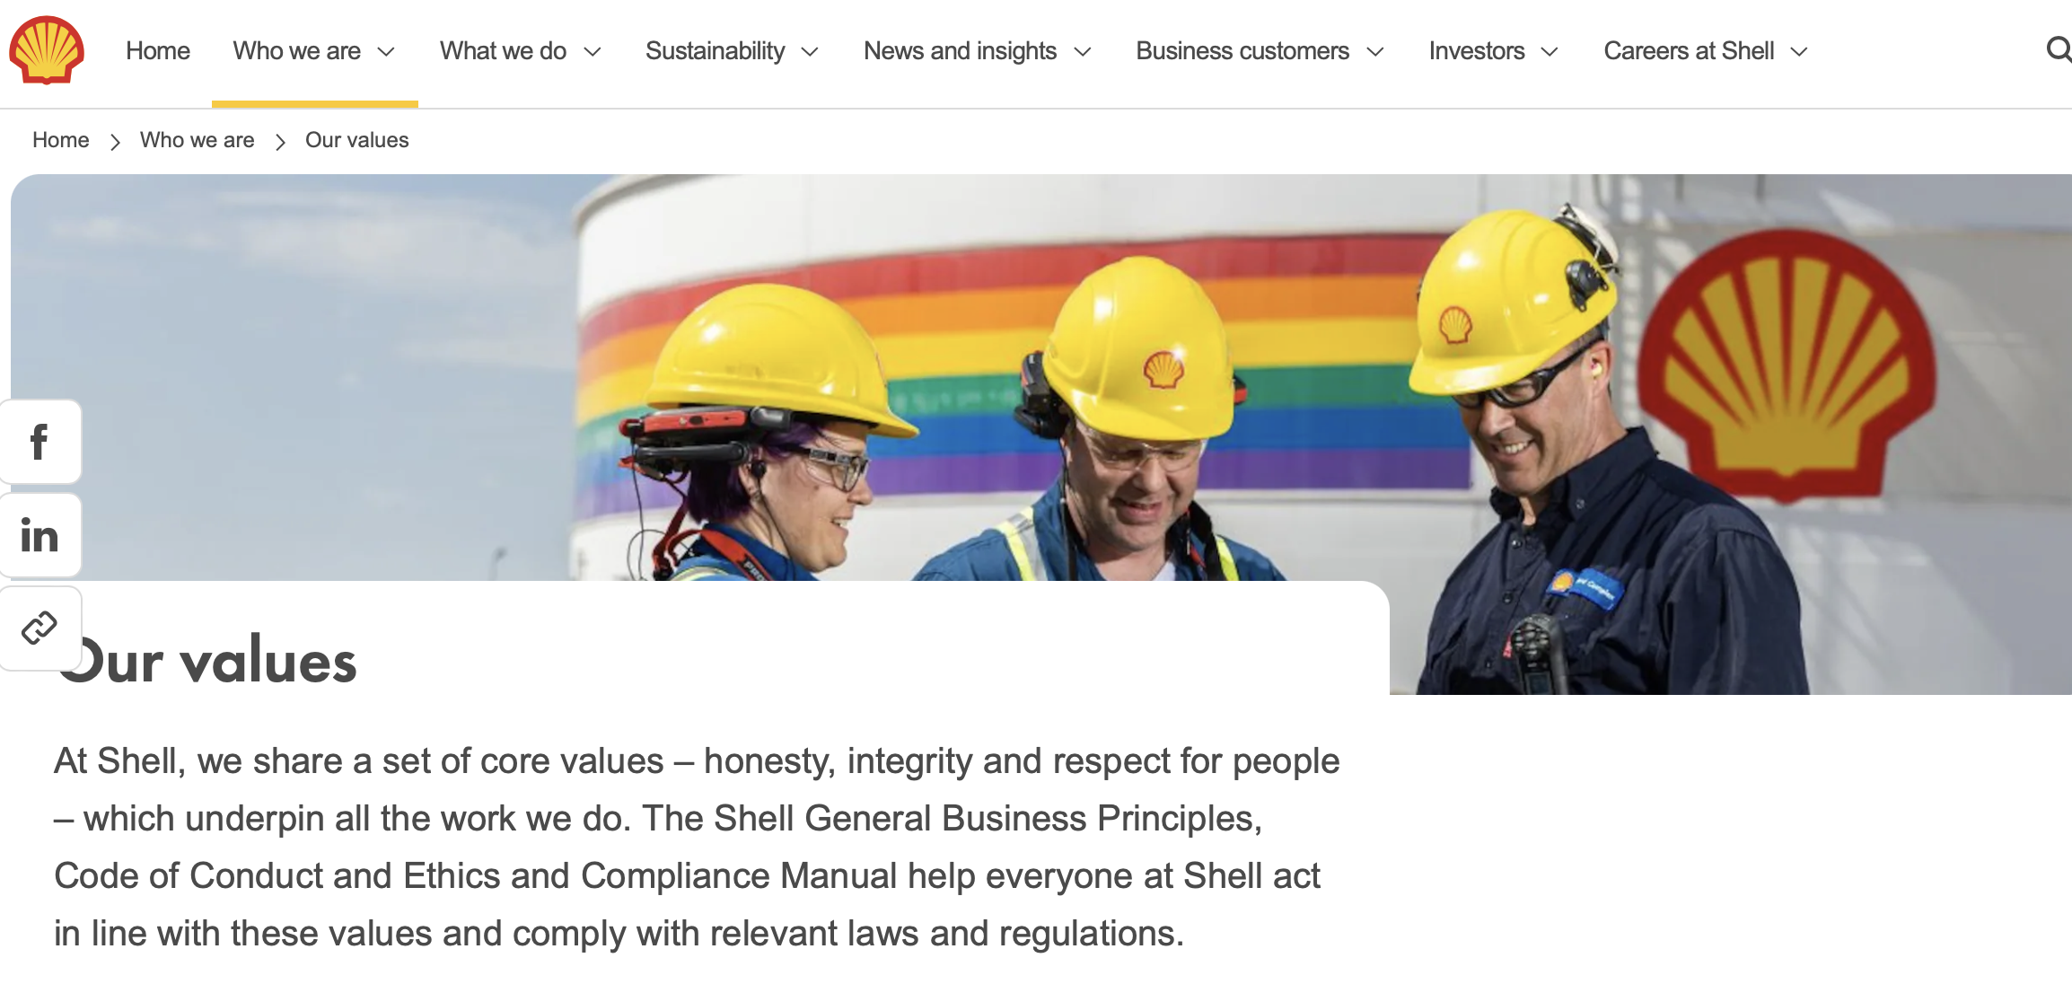
Learning 1 | Relevance for Shell
Email etiquettes benefits Shell greatly as it inculcates professionalism, efficiency, clarity and helps maintain relationships.
Professionalism that Shell inculcates in their employees plays a key role in their success.
Shell implements good email etiquettes by developing guidelines, training programs, incorporating in onboarding and leading by example.

Slide 9
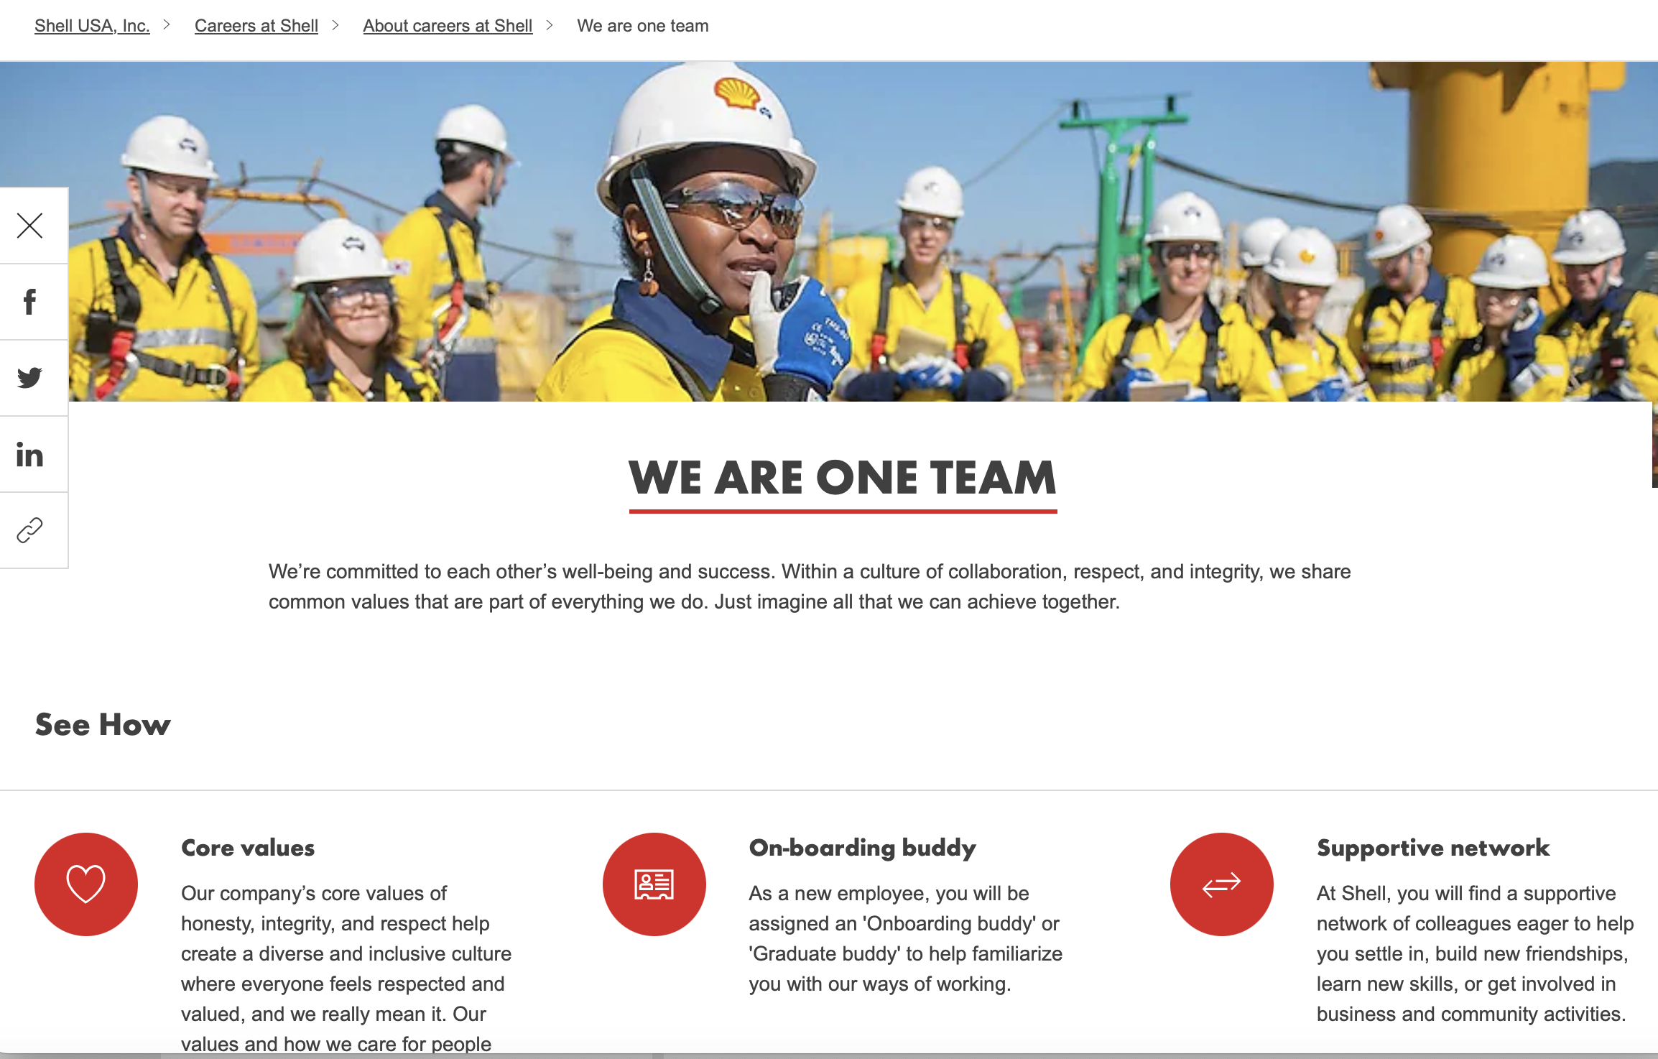
Learning 2 | Relevance for Shell
Shell implements team work by being inclusive and respecting everyone’s opinions.
Team work has played a major role in shell’s success.

Slide 10
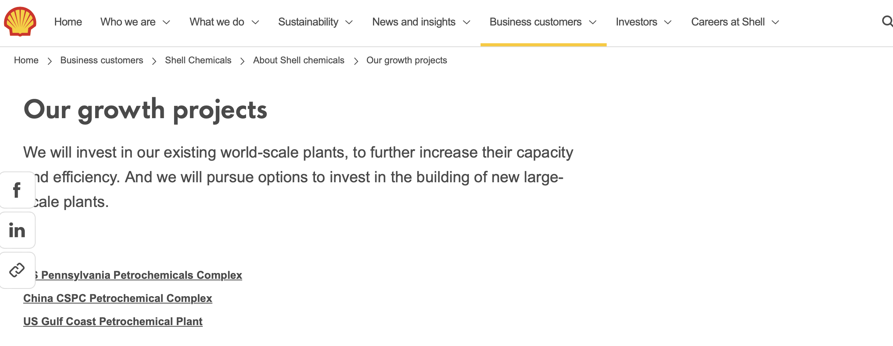
Learning 3 | Relevance for Shell
Shell uses Agile model during Software Project Development Cycle using Azure Devops.
Shell being an agile organizations reacts more flexibly to changes during Project development leading to successful projects.

Slide 11

Challenges in implementing learning

Slide 12
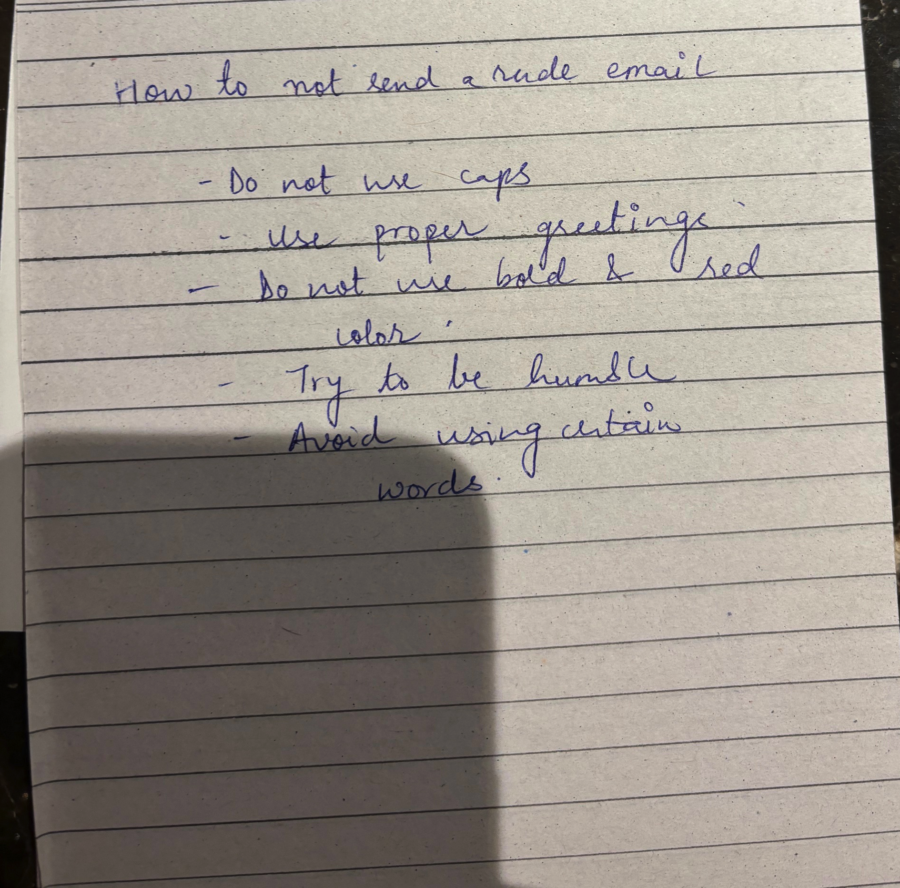
Challenge faced while implementing Learning 1
Challenges I faced while learning email etiquettes was to get a grip of the tone and clarity of email.
I am overcoming this challenges by learning do’s and don'ts's of email writing.

Slide 13
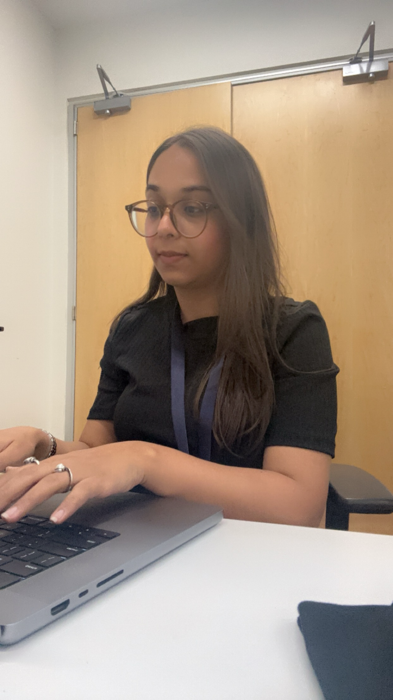
Challenge faced while implementing Learning 2
During a presentation discussions, the team members had different interpretations and different opinions.
We overcame it by calmly understanding each other’s thoughts.

Slide 14
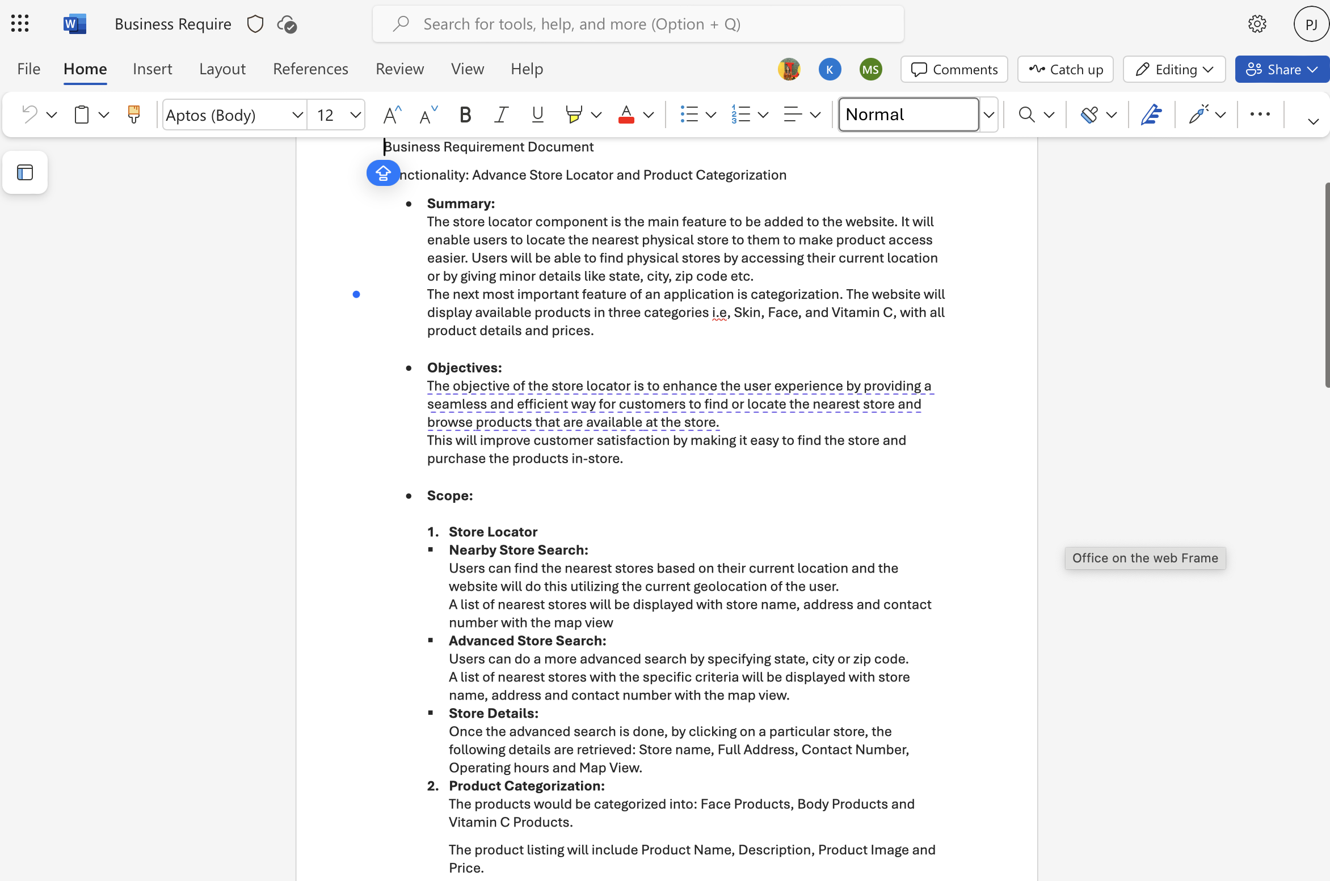
Challenge faced while implementing Learning 3
As a part of an activity we were asked to prepare both a BRD and SRS within an hour. Since it was the first time we had to prepare a BRD, it took us a while to start. But soon we implemented the learning from the class and finished it.

Slide 15

Action Plan

Slide 16
My Action Plan for this Week
Actions
Timeline
Status
Setting personal standards for professional behavior, including punctuality, respectful communication and dressing formally.
DAY 1: Self assessment and planning
DAY 2: Inculcating the skills that I lack.
Completed self assessment.
Applied professional standards and received feedback.

Slide 17

Learning is also Fun!

Slide 18
Learning is also Fun!
Importance of team work was taught by making us perform a fun activity where we were asked to tie a pen with 4 string, and the ends of the string had to be held by different students.
By coordinating and communication we had to write a 6 letter word.
[Add a graphic or a picture of how you/your team enjoyed the new learning]

Slide 19

Summary
The three-day session covered a wide range of important topics from professional etiquettes to stakeholder management.
The facilitator made the sessions interactive and engaging by planning out activities based on real life scenarios.
These activities helped us understand the topic thoroughly.
In the technical sessions, Business Required Document and Agile methodologies were covered in depth.
The technical sessions were just as engaging and informative.

Slide 20
Thank You

